Slide 1
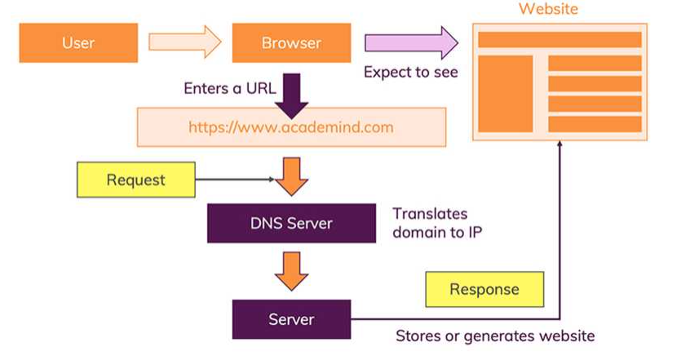
How does the web works?
The moment you enter an address in your browser and you hit ENTER, a lot of different ordered steps happen that are represented on the view below :
1 - The URL gets resolved : the browser fetches
the IP address from such a DNS server using the
“Domain Name” of the URL .the job of these DNS
servers is to translate domains to IP addresses.
DNS = “Domain Name System”.
2 - A Request is sent to the server of the website :
With the IP address resolved, the browser goes
ahead and makes a request to the server
with that IP address.
3 - The response of the server is parsed :
The browse receives the response sent by the server.
the data that’s enclosed in the response. And based
on that,it decides what to do.
4 - The page is rendered and displayed : the browser
goes through the HTML data returned by the server
and builds a website based on that.

Slide 2
What do you need to be a web developer?
Below is an overview of steps interested individuals can take to enter to web development career field:
1. Choose a development specialization :
Each element of a website is linked to something else, and it’s a complex job to build a website successfully. Depending on their specific jobs, web developers will be proficient in using various software programs (e.g. JavaScript frameworks, version control, CSS), and will have not only the specialized knowledge that characterizes their roles, but also an understanding of the process as a whole. Prior to starting out, it’s wise to get an understanding of the type of web development work that seems interesting—such as user interface design, mobile application development, front-end development or back-end development—to best set the stage for future education and training.
2. Get an education:
No specific degree or educational path exists for careers in web development, and it’s possible to become a web developer with or without a formal education. While it’s certainly possible to learn coding languages independently, there is more to web development than coding. Individuals who can implement coding skills within a broader context may have an advantage, and that’s where a formal education can help prospective developers gain foundational knowledge of web development principles and practices, expose them to project management and situations that require problem-solving, and encourage critical thinking.

Slide 3
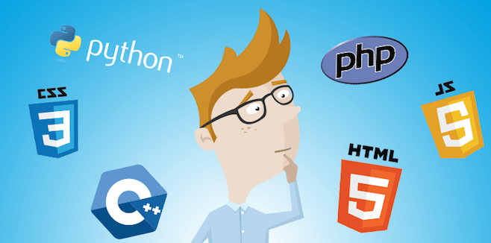
3. Develop technical skills:
Despite the real advantages that come with an organized education, web development is still a field in which concrete skills can trump education when it comes to employment opportunities. Companies want employees who can produce, and how or where something was learned is secondary to simply being able to do it. Prospective web developers should have expertise in the three core programming components: HTML, CSS, and JavaScript. They should also learn about frameworks such as Backbone, Bootstrap, and Foundation. Finally, to build applications, developers should be proficient in back-end languages such as Ruby, Java, PHP and tools such as Oracle and SQL Server.
4. Practice your coding skills:
Web developers learn by doing. Set up a Github account and push code to the site. An active Github profile can get the attention of employers searching through stacks of resumes, and demonstrates not only what a candidate does to solve programming issues, but also the thinking and strategies behind those solutions. Practicing coding and getting used to using Git prepares developers to work as part of a team, as well as manage complicated site and application builds.
5. Lunch an online portfolio:
Employers want to see results, such as current examples of successful site and application builds. With a portfolio, developers can test new technologies and tools, as well as demonstrate their coding talent and technical capabilities. Standout portfolios can help candidates clear that crucial first hurdle: landing a job interview.

Slide 4

What’s the role of a web developer?
A web developer is responsible for programming the code that “tells” a website how to function. A developer builds a website from the bottom up, which means designing it in such a way that end users have no difficulty navigating the site. The website should not be so simple that it does not appeal to advanced users, nor should it be so complicated that the beginner is easily lost in the process.
Web development can be divided into three parts: code that executes in a web browser and determines what customers or clients will see when they land on a website (client-side scripting); code that executes on a web server and powers the behind-the-scenes mechanics of how a website works (server-side scripting); and database technology, which helps to keep a website running smoothly and efficiently. Large-scale web projects often divide these tasks among multiple web developers.

